Slide 1
Introduction to Operating System
UNIT-1

Slide 2
Index
What is an Operating System?
Roles & responsibilities of OS
Objectives of OS
Early Systems
Types of OS
Process Concepts
Operations on Processes
Cooperating Processes
Threads
Inter-process Communication

Slide 3
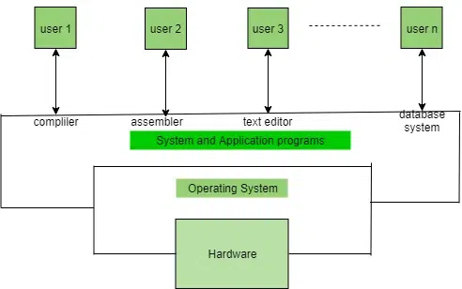
What is an Operating System?
Operating System lies in the category of system software. It basically manages all the resources of the computer.
An operating system acts as an interface between the software and different parts of the computer or the computer hardware.
The operating system is designed in such a way that it can manage the overall resources and operations of the computer.
An operating system is a layer of software on a bare hardware machine that performs two basic functions :
Resource Management
Virtual machine management (User friendliness)

Slide 4
Roles & Responsibilities
Resource Management: The operating system manages and allocates memory, CPU time, and other hardware resources among the various programs and processes running on the computer.
Process Management: The operating system is responsible for starting, stopping, and managing processes and programs. It also controls the scheduling of processes and allocates resources to them.
Memory Management: The operating system manages the computer’s primary memory and provides mechanisms for optimizing memory usage.
Security: The operating system provides a secure environment for the user, applications, and data by implementing security policies and mechanisms such as access controls and encryption.
Job Accounting: It keeps track of time and resources used by various jobs or users.
File Management: The operating system is responsible for organizing and managing the file system, including the creation, deletion, and manipulation of files and directories.
Device Management: The operating system manages input/output devices such as printers, keyboards, mice, and displays. It provides the necessary drivers and interfaces to enable communication between the devices and the computer.

Slide 5
Networking: The operating system provides networking capabilities such as establishing and managing network connections, handling network protocols, and sharing resources such as printers and files over a network.
User Interface: The operating system provides a user interface that enables users to interact with the computer system. This can be a Graphical User Interface (GUI), a Command-Line Interface (CLI), or a combination of both.
Backup and Recovery: The operating system provides mechanisms for backing up data and recovering it in case of system failures, errors, or disasters.
Virtualization: The operating system provides virtualization capabilities that allow multiple operating systems or applications to run on a single physical machine. This can enable efficient use of resources and flexibility in managing workloads.
Performance Monitoring: The operating system provides tools for monitoring and optimizing system performance, including identifying bottlenecks, optimizing resource usage, and analyzing system logs and metrics.
Time-Sharing: The operating system enables multiple users to share a computer system and its resources simultaneously by providing time-sharing mechanisms that allocate resources fairly and efficiently.
System Calls: The operating system provides a set of system calls that enable applications to interact with the operating system and access its resources. System calls provide a standardized interface between applications and the operating system, enabling portability and compatibility across different hardware and software platforms.
Error-detecting Aids: These contain methods that include the production of dumps, traces, error messages, and other debugging and error-detecting methods.

Slide 6
Objectives of OS
Convenient to use: One of the objectives is to make the computer system more convenient to use in an efficient manner.
User Friendly: To make the computer system more interactive with a more convenient interface for the users.
Easy Access: To provide easy access to users for using resources by acting as an intermediary between the hardware and its users.
Management of Resources: For managing the resources of a computer in a better and faster way.
Controls and Monitoring: By keeping track of who is using which resource, granting resource requests, and mediating conflicting requests from different programs and users.
Fair Sharing of Resources: Providing efficient and fair sharing of resources between the users and programs.

Slide 7
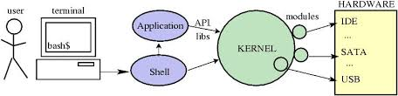
Components of OS
Shell :
A shell is an environment or a special user program which provide an interface to user to use operating system services. It executes programs based on the input provided by the user.
Kernel :
Kernel is the heart and core of an Operating System that manages operations of computer and hardware.

Slide 8
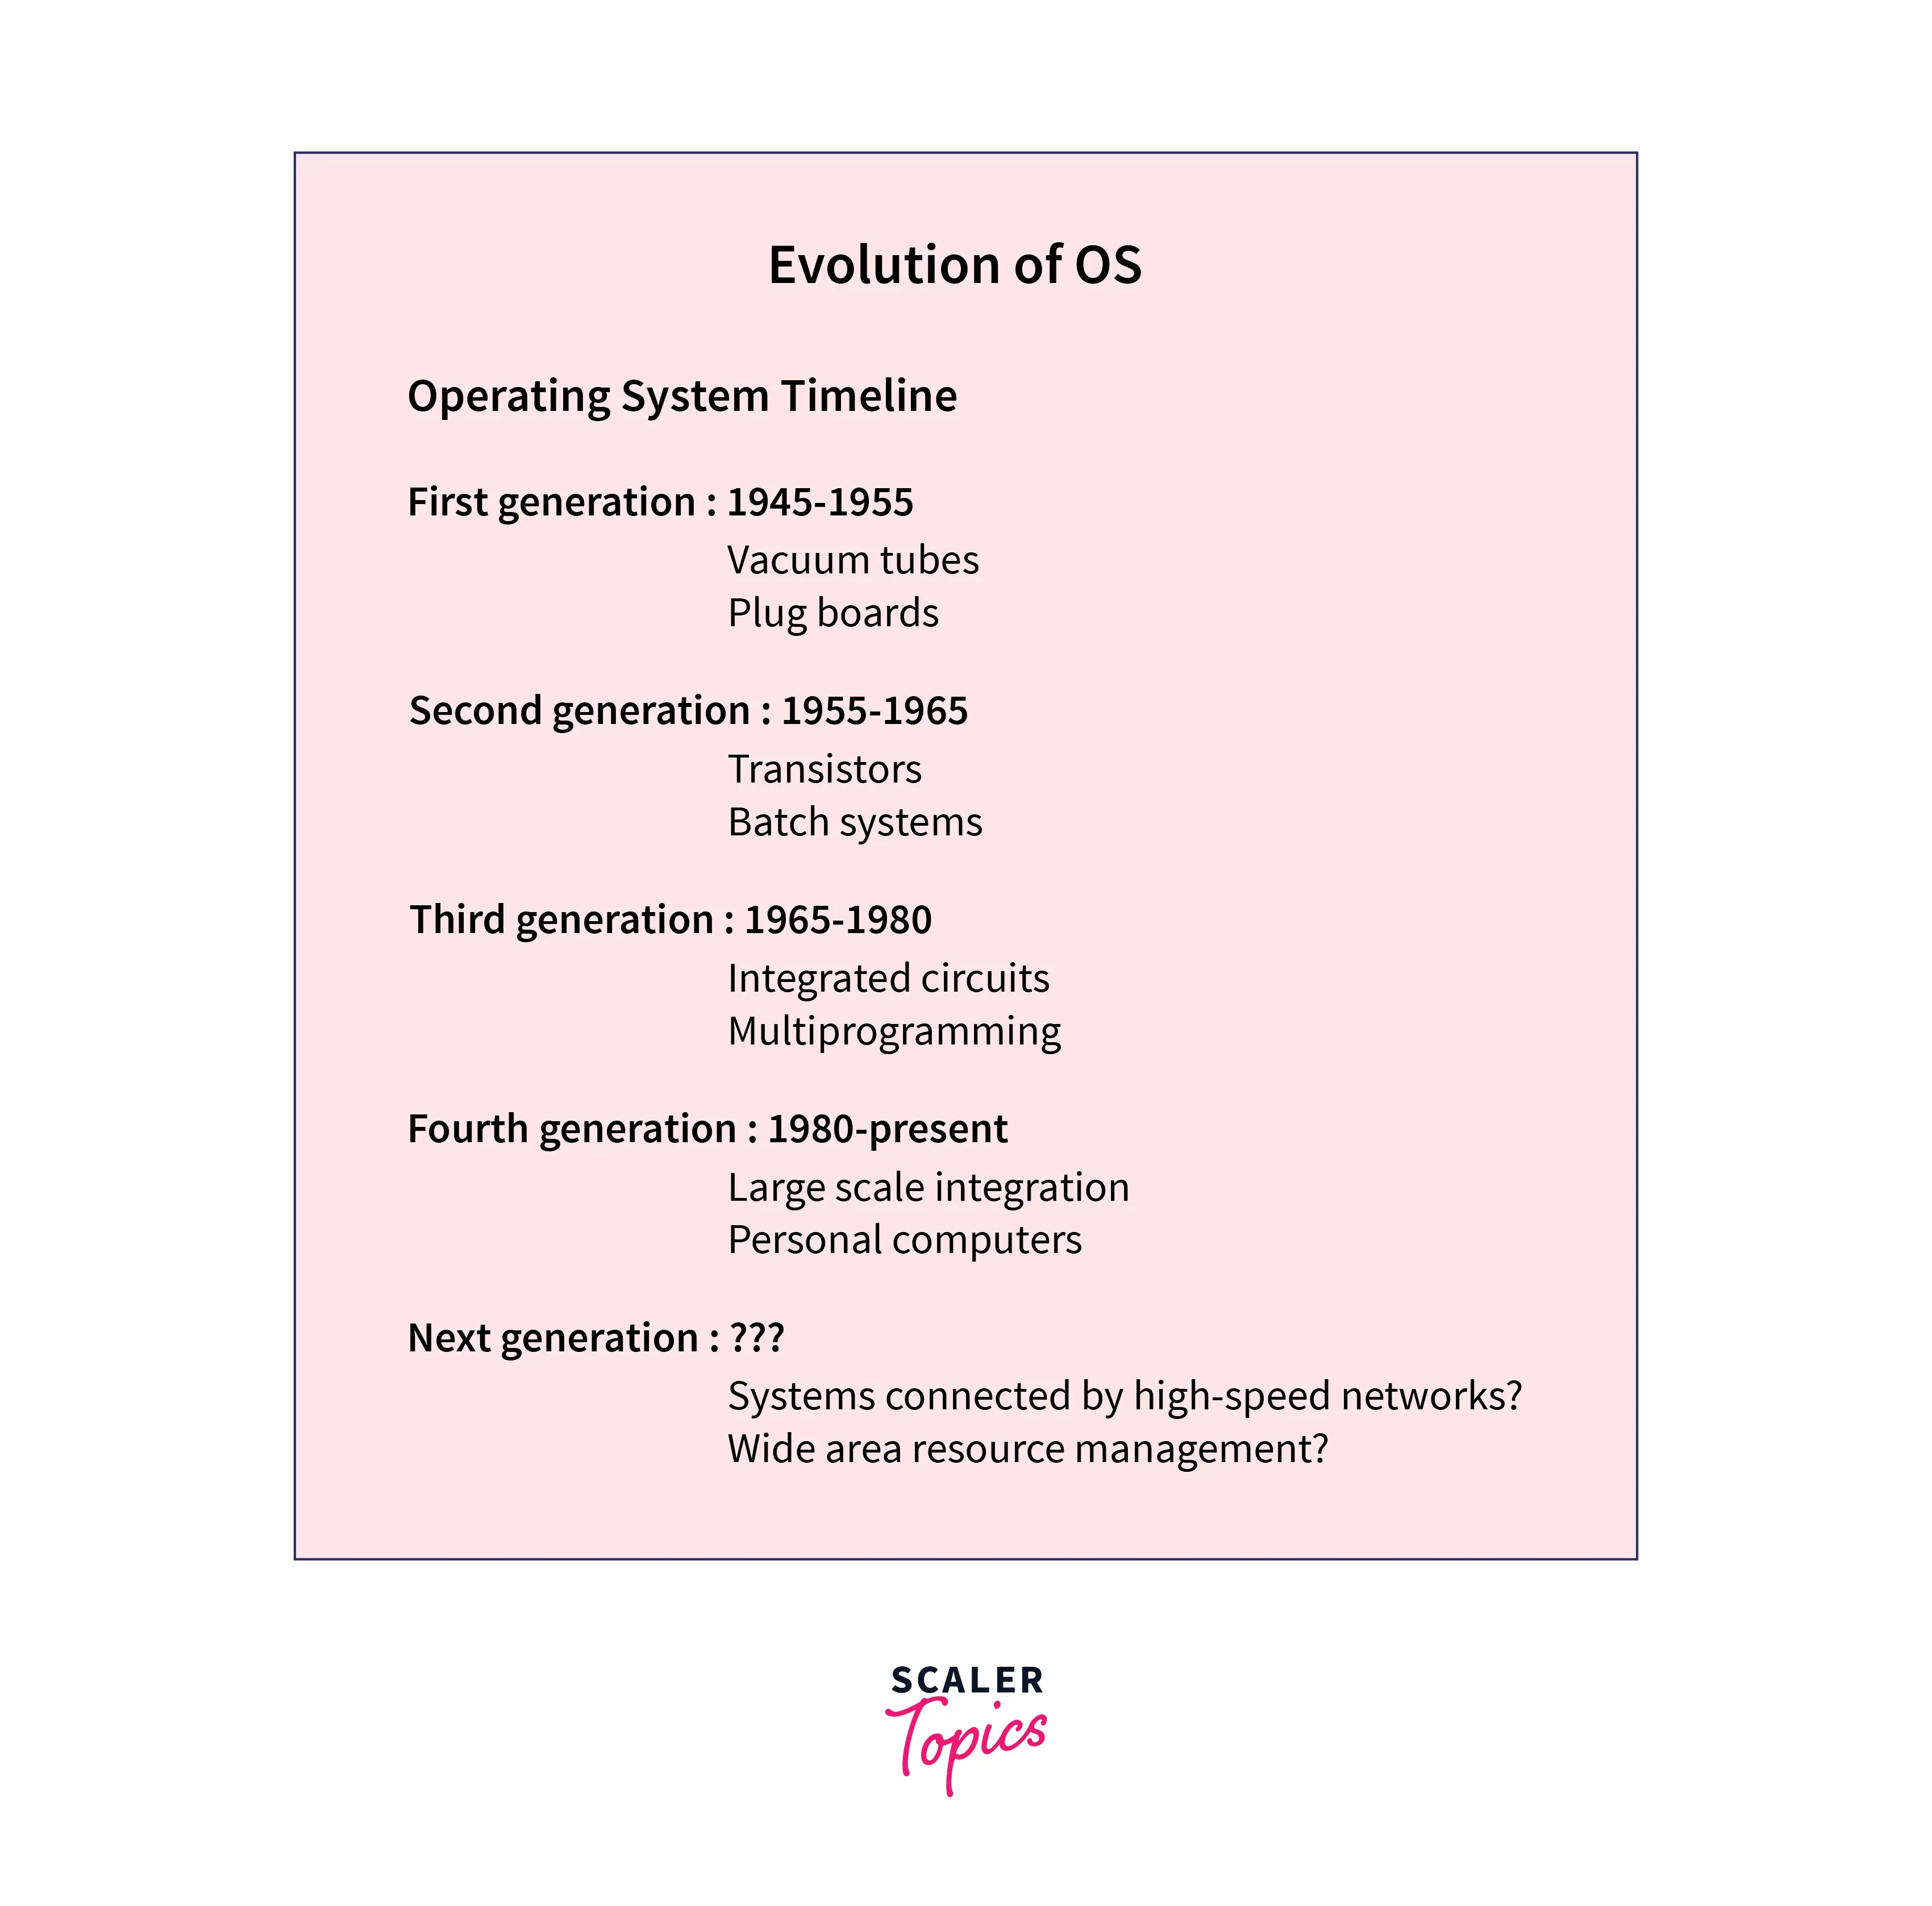
Early Systems- History of OS

Slide 9
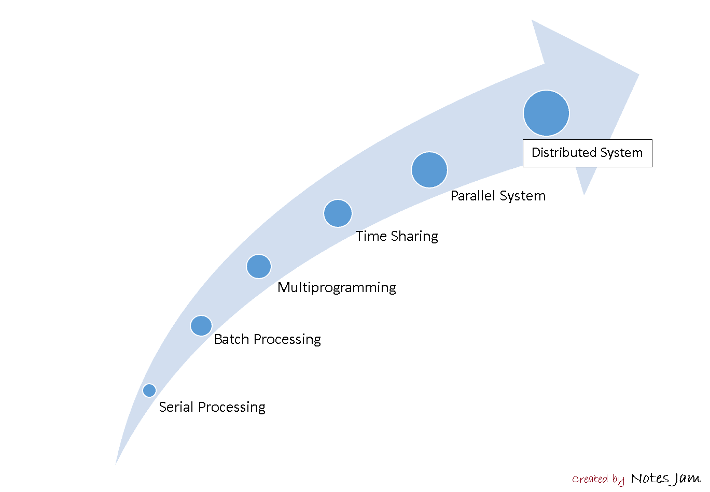
Evolution of OS

Slide 10
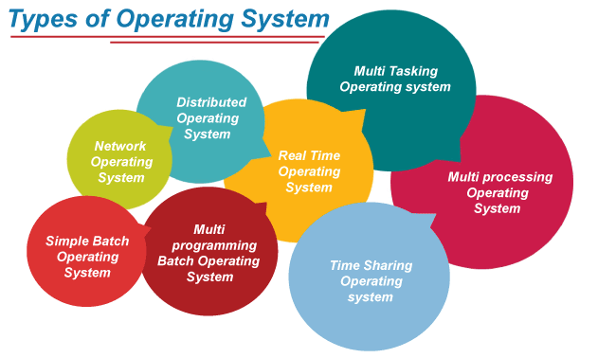
Types of OS

Slide 11
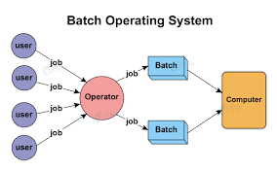
1. Simple Batch Operating System
It is an open-source operating system designed to manage multiple jobs in sequence.
It is a type of OS that is used to improve the efficiency of a business by allowing it to run multiple tasks at the same time.
The users of a batch OS do not interact with the computer directly. Each user prepares his job on an off-line device like punch cards and submits it to the computer operator.
To speed up processing, jobs with similar needs are batched together and run as a group.
The programmers leave their programs with the operator and the operator then sorts the programs with similar requirements into batches.
By scheduling and processing jobs in batches, the system can maximize the utilization of the available resources such as CPU time, memory, and storage.

Slide 12
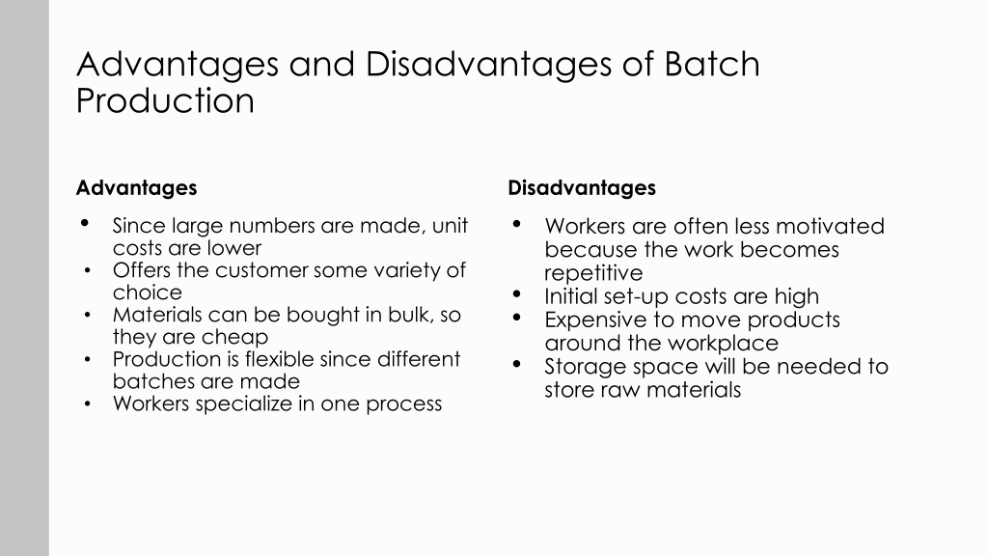

Slide 13
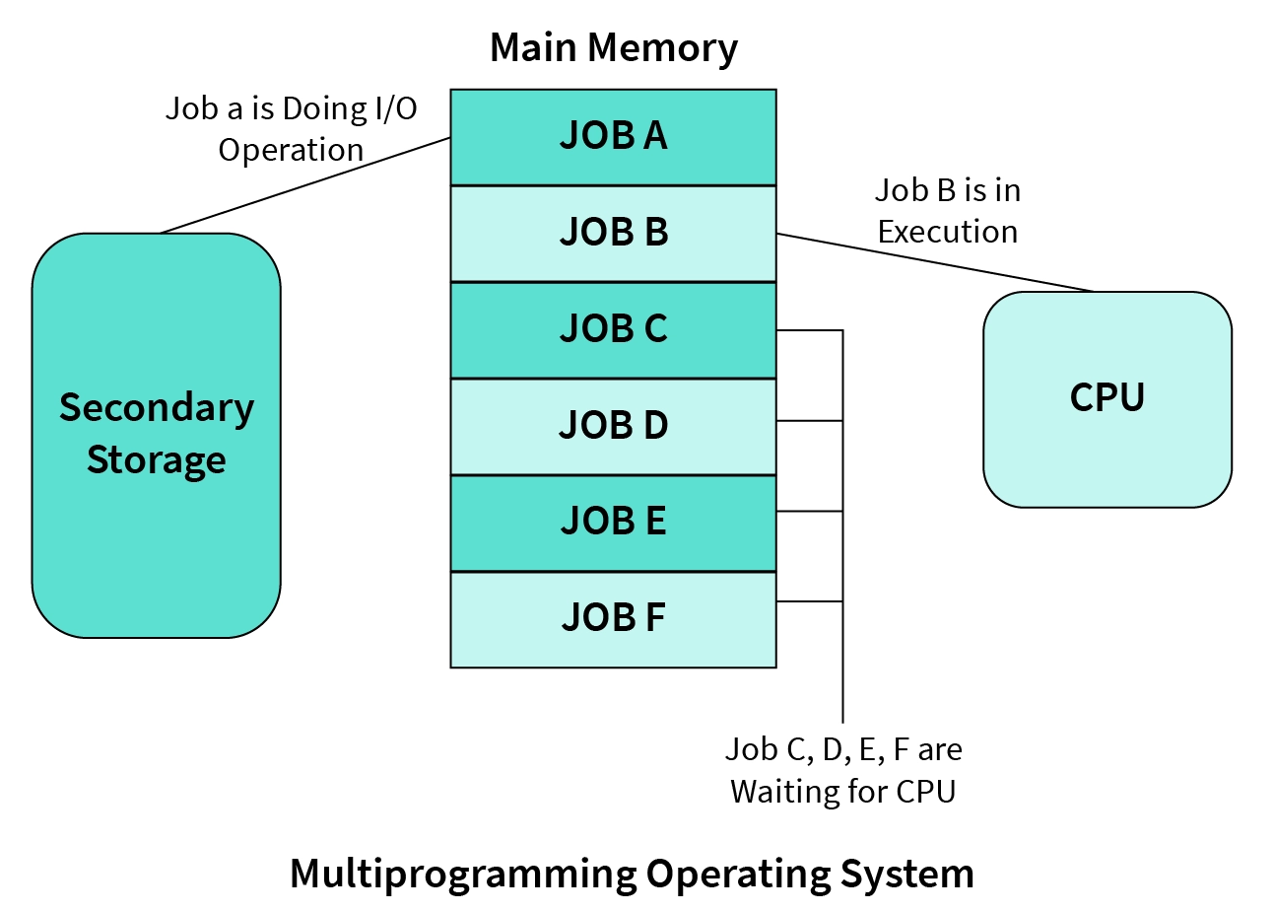
2. Multi-Programmed OS
When more than one program can execute in an operating system then this is termed a multiprogramming operating system.
When a program undergoes in waiting state for an input/output operation, the CPU remains idle which leads to underutilization of CPU and thus poor performance.
The major task of multiprogramming is to maximize the utilization of resources.
Multiprogramming was developed in 1950s. It was first used in mainframe computing (i.e. mainframes are high-performance computers with large amounts of memory and data processors that process billions of simple calculations and transactions in real time).
Multiprogramming is broadly classified into two types namely
Multi-user operating system
Multitasking operating system

Slide 14
Multiprogramming OS (Cont.’)
Advantages :-
Need Single CPU for implementation.
Context switch between process.
Switching happens when current process undergoes waiting state.
CPU idle time is reduced.
High resource utilization.
High Performance.
Disadvantages :-
Prior knowledge of scheduling algorithms is required.
If it has a large number of jobs, then long-term jobs will have to require a long wait.
Memory management is needed in the operating system because all types of tasks are stored in the main memory.
Using multiprogramming up to a larger extent can cause a heat-up issue.

Slide 15
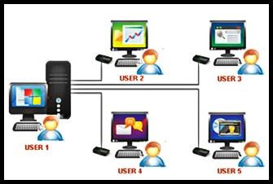
A multi-user operating system allows many users to share processing time on a powerful central computer on different terminals.
The operating system does this by quickly switching between terminals, each receiving a limited amount of CPU time on the central computer.
Operating systems change so rapidly between terminals that each user appears to have constant access to the central computer. If there are many users on such a system, the time it takes for the central computer to respond may become more apparent.

Slide 16
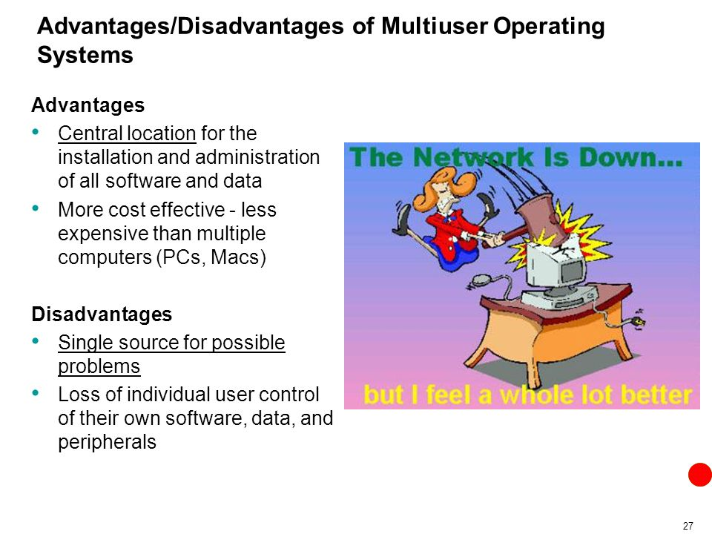

Slide 17
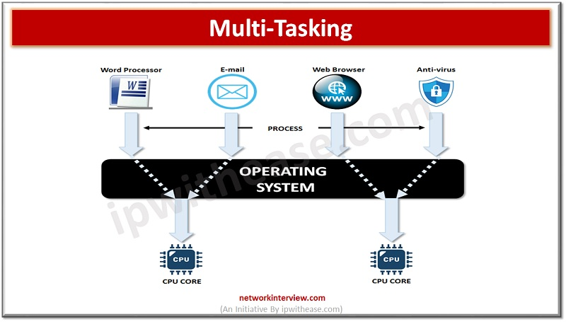
Multitasking is an operating system that allows you to run more than one program simultaneously.
The operating system does this by moving each program in and out of memory one at a time. When a program runs out of memory, it is temporarily stored on disk until it is needed again.
Multitasking is a method that is divided into two types:
Preemptive Scheduling algorithm: In the preemptive scheduling algorithm if more than one process wants to enter into the critical section then it will be allowed and it can enter into the critical section without any interruption only if no other progress is in the critical section.
Non-Preemptive scheduling algorithm: If a process gets a critical section then it will not leave the critical section until or unless it works gets done.

Slide 18
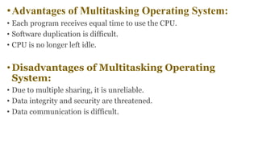

Slide 19
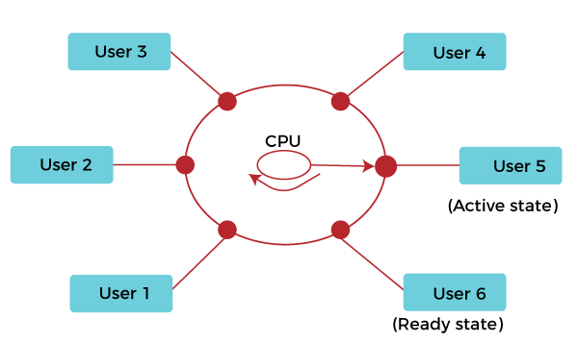
3. Time-sharing OS
Time-sharing is a logical extension of multiprogramming.
It allows multiple users to share computers simultaneously.
With each action or order at a time the shared system becomes smaller, so only a little CPU time is required for each user.
As the system rapidly switches from one user to another, each user is given the impression that the entire computer system is dedicated to its use, although it is being shared among multiple users.
This OS uses CPU scheduling and multiprogramming to provide each user with a small portion of a time. Computer systems that were designed primarily as batch systems have been modified to time-sharing systems.

Slide 20
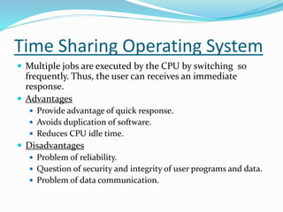

Slide 21

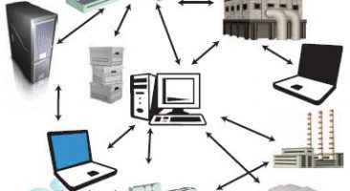

Question- Can a time-sharing system prioritize certain processes or users?

Slide 22
Yes, time-sharing systems can prioritize certain processes or users based on specific criteria.
Scheduling algorithms often include priority-based scheduling, where processes with higher priority are allocated more CPU time or given preference in execution.
This allows critical or interactive tasks to receive faster response times. However, it’s important to balance priorities to ensure fairness and prevent lower priority processes from being starved of resources.

Slide 23
Parallel Systems
A system consisting of more than one processor that is tightly coupled (i.e., heavy sharing of resources like bus, clock, memory, I/O devices) is a parallel system.
The systems that can process the data simultaneously, and increase the computational speed of a computer system. In these systems, applications are running on multiple computers linked by communication lines.
These systems will increase the CPU throughput (number of jobs per unit time), reduce time required for job execution.
Parallel Systems are designed to speed up the execution of programs by dividing the programs into multiple fragments and processing these fragments at the same time.

Slide 24
Advantages of Parallel Systems:
High Performance: Parallel systems can execute computationally intensive tasks more quickly compared to single processor systems.
Cost Effective: Parallel systems can be more cost-effective compared to distributed systems, as they do not require additional hardware for communication.
Disadvantages of Parallel Systems:
Limited Scalability: Parallel systems have limited scalability as the number of processors or cores in a single computer is finite.
Complexity: Parallel systems are more complex to program and debug compared to single processor systems.
Synchronization Overhead: Synchronization between processors in a parallel system can add overhead and impact performance.

Slide 25
Distributed Systems
It comprises of a large central computer to which a large number of remote terminals are attached.
A distributed system is a model where distributed applications are running on multiple computers linked by a communications network.
Sometimes, it is also called loosely coupled systems because in which each processor has its own local memory and processing units.
LOCUS and MICROS are some examples of distributed operating systems.

Slide 26
Advantages of Distributed Systems:
Scalability: Distributed systems can be easily scaled by adding more computers to the network.
Fault Tolerance: Distributed systems can recover from failures by redistributing work to other computers in the network.
Geographical Distribution: Distributed systems can be geographically distributed, allowing for better performance and resilience.

Slide 27
Disadvantages of Distributed Systems:
Complexity: Distributed systems are more complex to design and maintain compared to single computer systems.
Communication Overhead: Communication between computers in a distributed system adds overhead and can impact performance.
Security: Distributed systems are more vulnerable to security threats, as the communication between computers can be intercepted and compromised.

Slide 28
Real Time OS
Real-time operating systems (RTOS) are used in environments where a large number of events, mostly external to the computer system, must be accepted and processed in a short time or within certain deadlines
Such applications are :-
Industrial control, telephone switching equipment, flight control, and real-time simulations
This system is time-bound and has a fixed deadline.
Examples of the real-time operating systems: Airline traffic control systems, Command Control Systems, Airlines reservation system, Heart Pacemaker, Network Multimedia Systems, Robot etc.

Slide 29
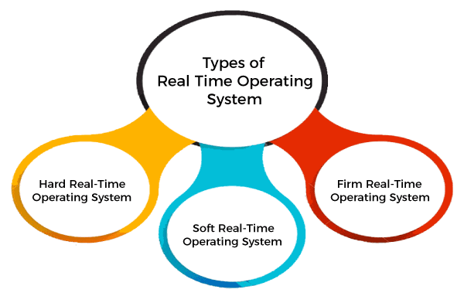
Types of RTOS

Slide 30
1. Hard Real-Time operating system
These operating systems guarantee that critical tasks be completed within a range of time.
For example,
a robot is hired to weld a car body. If the robot welds too early or too late, the car cannot be sold, so it is a hard real-time system that requires complete car welding by robot hardly on the time.,
scientific experiments,
medical imaging systems,
industrial control systems,
weapon systems, robots,
air traffic control systems, etc.

Slide 31
2. Soft real-time operating system
This operating system provides some relaxation in the time limit.
For example –
Multimedia systems,
digital audio systems etc.
Explicit, programmer-defined and controlled processes are encountered in real-time systems
Multitasking operation is accomplished by scheduling processes for execution independently of each other. Each process is assigned a certain level of priority that corresponds to the relative importance of the event that it services. The processor is allocated to the highest priority processes. This type of schedule, called, priority-based preemptive scheduling is used by real-time systems.

Slide 32
3. Firm Real-time Operating System
RTOS of this type have to follow deadlines as well. In spite of its small impact, missing a deadline can have unintended consequences, including a reduction in the quality of the product. Example: Multimedia applications

Slide 33
Advantages and Disadvantages of Real time OS
Advantages-
1. Maximum consumption
2. Task shifting
3. Focus on applications
4. Memory management
Disadvantages-
1. Use heavy resources
2. Complex Algorithm
3. Device driver & interrupt signals & etc.

Slide 34
Process Concepts
Q. What is a Process?
A. A process/task is an instance of a program in execution. It performs the required functions of its related program.
A program is just a passive entity whereas a process is an active entity.
To accomplish its task, a process needs certain resources like CPU, memory, files & I/O devices.
OS has following functions related to the process management :-
a) Process creation c) Process suspending
b) Process scheduling d) Process resuming

Slide 35
e) To provide process synchronization for resource sharing among concurrent processes.
f) To provide inter-process communication among concurrent processes.
g) To provide mechanisms for deadlock handling
h) Process termination

Slide 36
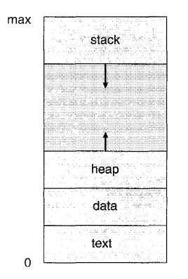
What does a process look like in memory?
Explanation of Process :
Text Section: A Process, sometimes known as the Text Section, also includes the current activity represented by the value of the Program Counter.
Stack: The stack contains temporary data, such as function parameters, returns addresses, and local variables.
Data Section: Contains the global variable.
Heap Section: Dynamically allocated memory to process during its run time.

Slide 37
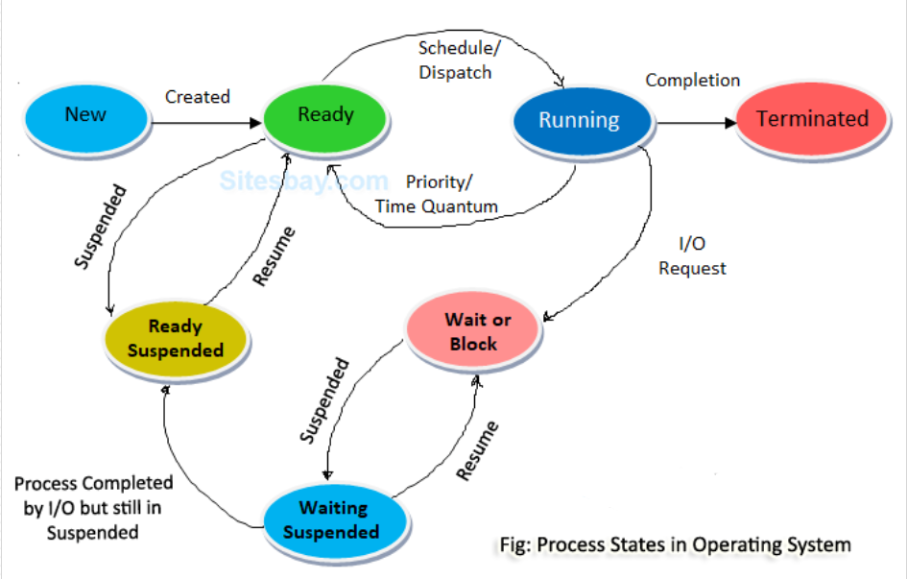
Process States OR Process Life Cycle

Slide 38
As a process executes, it changes state. The state of a process is defined in part by the current activity of that process. Each process may be in one of the following states:
• New. The process is being created.
• Running. Instructions are being executed.
• Waiting. The process is waiting for some event to occur (such as an I/O completion or reception of a signal).
• Ready. The process is waiting to be assigned to a processor.
• Terminated. The process has finished execution.

Slide 39
Process Attributes OR Context of Process
A process has the following attributes.
Process Id: A unique identifier assigned by the operating system
Process State: Can be ready, running, etc.
CPU registers: Like the Program Counter (CPU registers must be saved and restored when a process is swapped in and out of the CPU)
Accounts information: Amount of CPU used for process execution, time limits, execution ID, etc.
I/O status information: For example, devices allocated to the process, open files, etc.
CPU scheduling information: For example, Priority (Different processes may have different priorities, for example, a shorter process assigned high priority in the shortest job first scheduling)

Slide 40
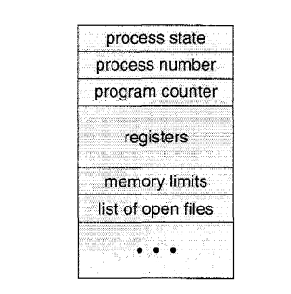
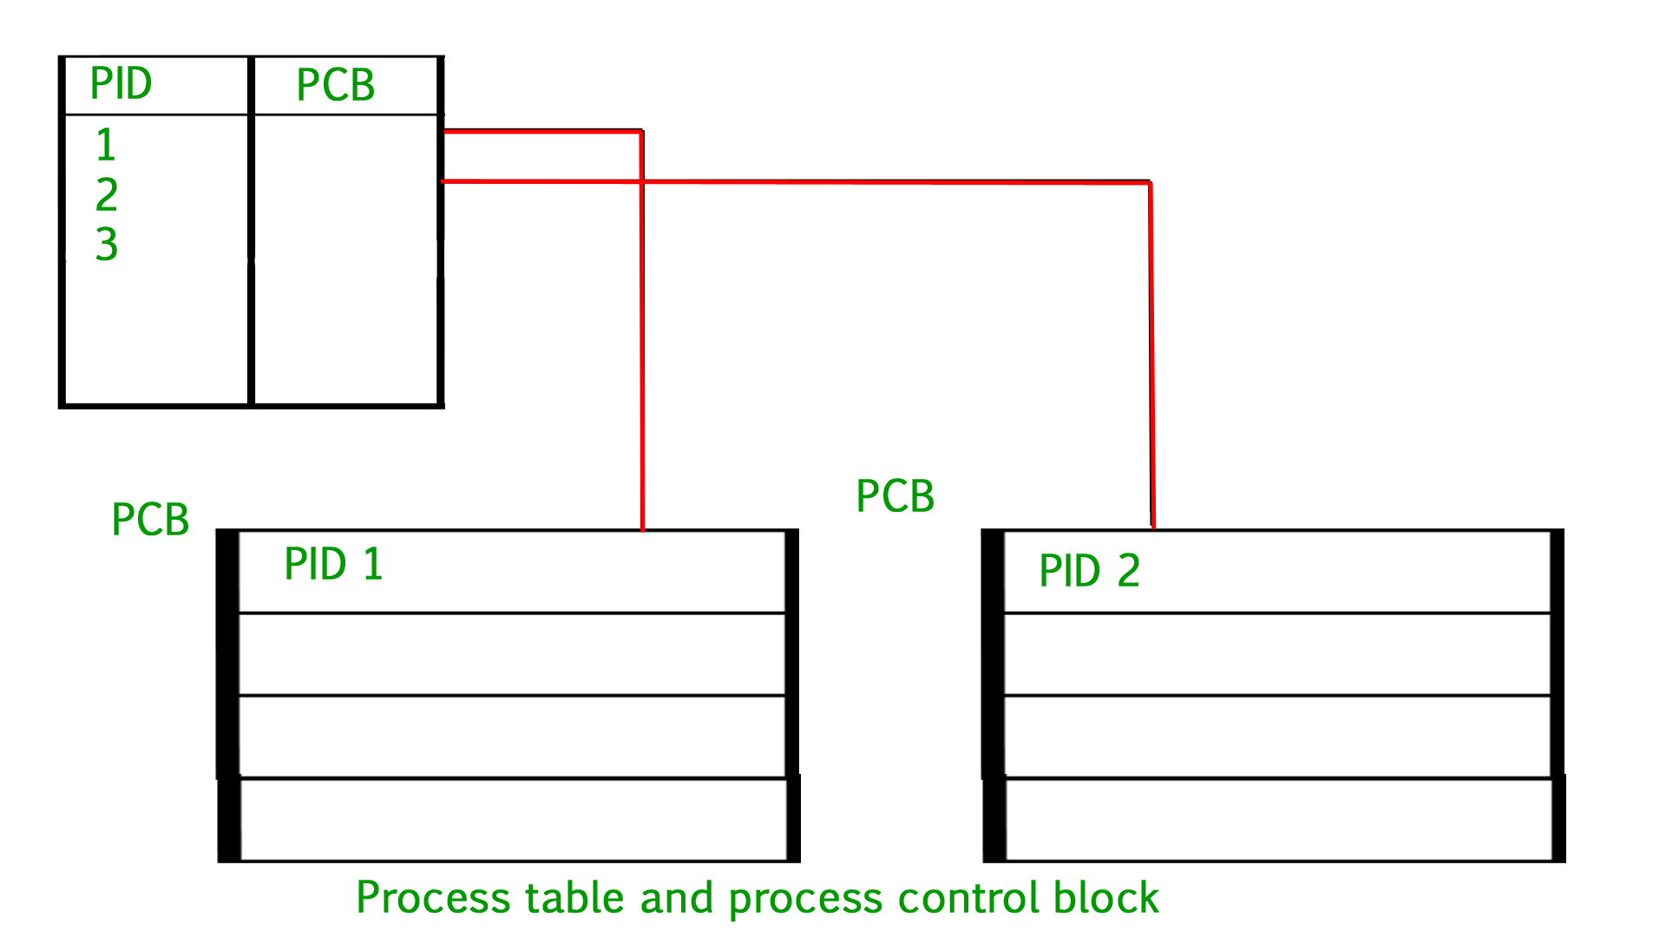
Process Control Block (PCB)

Slide 41
Each process is represented in the operating system by a process control block (PCB) also called a task control block. It contains many pieces of information associated with a specific process, including these:
Pointer – It is a stack pointer which is required to be saved when the process is switched from one state to another to retain the current position of the process.
Process state – It stores the respective state of the process.
Process number – Every process is assigned with a unique id known as process ID or PID which stores the process identifier.
Program counter – It stores the counter which contains the address of the next instruction that is to be executed for the process.
Register – These are the CPU registers which includes: accumulator, base, registers and general purpose registers.
Memory limits – This field contains the information about memory management system used by operating system. This may include the page tables, segment tables etc.
Open files list – This information includes the list of files opened for a process.

Slide 42
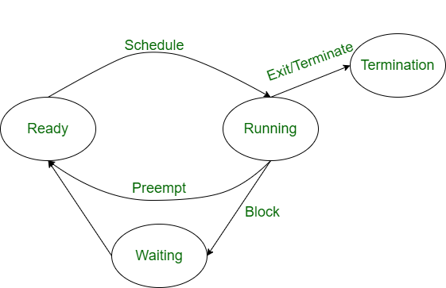
Operations on Processes
The execution of a process is a complex activity. It involves various operations. Following are the operations that are performed while execution of a process:

Slide 43
Creation- Process creation means the construction of a new process for execution. This might be performed by the system, the user, or the old process itself. There are several events that lead to the process creation.
When we start the computer, the system creates several background processes.
A user may request to create a new process.
A process can create a new process itself while executing.
The batch system takes initiation of a batch job.
Scheduling/Dispatching- The event or activity in which the state of the process is changed from ready to run. It means the operating system puts the process from the ready state into the running state. Dispatching is done by the operating system when the resources are free or the process has higher priority than the ongoing process. There are various other cases in which the process in the running state is preempted and the process in the ready state is dispatched by the operating system.

Slide 44
Blocking- When a process invokes an input-output system call that blocks the process, and operating system is put in block mode.
Block mode is basically a mode where the process waits for input-output. Hence on the demand of the process itself, the operating system blocks the process and dispatches another process to the processor. Hence, in process-blocking operations, the operating system puts the process in a ‘waiting’ state.
Preemption- When a timeout occurs that means the process hadn’t been terminated in the allotted time interval and the next process is ready to execute, then the operating system preempts the process.
This operation is only valid where CPU scheduling supports preemption. Basically, this happens in priority scheduling where on the incoming of high priority process the ongoing process is preempted. Hence, in process preemption operation, the operating system puts the process in a ‘ready’ state.

Slide 45
Process Termination- Process termination is the activity of ending the process. In other words, process termination is the relaxation of computer resources taken by the process for the execution. Like creation, in termination also there may be several events that may lead to the process of termination. Some of them are:
The process completes its execution fully and it indicates to the OS that it has finished.
The operating system itself terminates the process due to service errors.
There may be a problem in hardware that terminates the process.
One process can be terminated by another process.

Slide 46
Process Schedulers in Operating System
Process scheduling is the activity of the process manager that handles the removal of the running process from the CPU and the selection of another process on the basis of a particular strategy.
Process scheduling is an essential part of a Multiprogramming operating system. Such operating systems allow more than one process to be loaded into the executable memory at a time and the loaded process shares the CPU using time multiplexing.
There are three types of process schedulers: -
Long-term scheduler
Short-term scheduler
Medium-term scheduler

Slide 47
Long-term Scheduler | Short-term Scheduler | Medium-term Scheduler
It is a job scheduler | It is a CPU scheduler | It is a process-swapping scheduler.
Generally, Speed is lesser than short term scheduler | Speed is the fastest among all of them. | Speed lies in between both short and long-term schedulers.
It controls the degree of multiprogramming | It gives less control over how much multiprogramming is done. | It reduces the degree of multiprogramming.
It is barely present or nonexistent in the time-sharing system. | It is a minimal time-sharing system. | It is a component of systems for time sharing.
It can re-enter the process into memory, allowing for the continuation of execution. | It selects those processes which are ready to execute | It can re-introduce the process into memory and execution can be continued.

Slide 48
Categories in Scheduling
Scheduling falls into one of two categories:
Non-preemptive: In this case, a process’s resource cannot be taken before the process has finished running. When a running process finishes and transitions to a waiting state, resources are switched.
Preemptive: In this case, the OS assigns resources to a process for a predetermined period of time. The process switches from running state to ready state or from waiting for state to ready state during resource allocation. This switching happens because the CPU may give other processes priority and substitute the currently active process for the higher priority process.

Slide 49
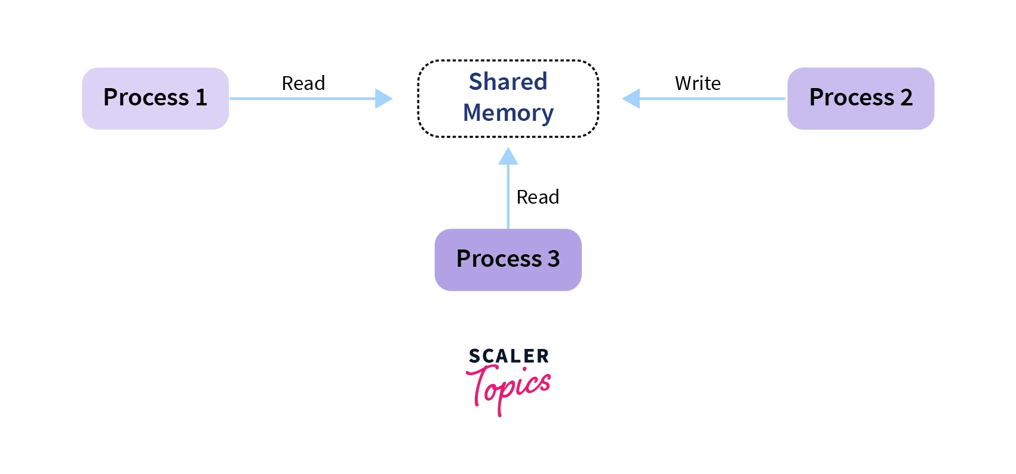
Cooperating Process
Cooperating Processes are those processes that depend on other processes or processes. They work together to achieve a common task in an operating system. These processes interact with each other by sharing the resources such as CPU, memory, and I/O devices to complete the task.

Slide 50
Threads
Within a program, a Thread is a separate execution path. It is a lightweight process that the operating system can schedule and run concurrently with other threads.
OR
A thread is a single sequence stream within a process. Threads are also called lightweight processes as they possess some of the properties of processes.
The operating system creates and manages threads, and they share the same memory and resources as the program that created them. This enables multiple threads to collaborate and work efficiently within a single program.
Each thread belongs to exactly one process.

Slide 51
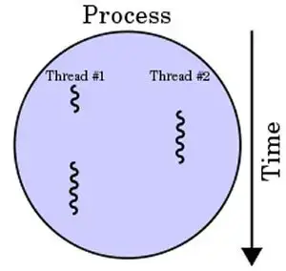
Difference Between Process and Thread
The primary difference is that threads within the same process run in a shared memory space, while processes run in separate memory spaces.
Threads are not independent of one another like processes are, and as a result, threads share with other threads their code section, data section, and OS resources (like open files and signals).
But, like a process, a thread has its own program counter (PC), register set, and stack space.

Slide 52
Why Do We Need Thread?
Threads run in parallel improving the application performance. Each such thread has its own CPU state and stack, but they share the address space of the process and the environment.
Threads can share common data so they do not need to use interprocess communication. Like the processes, threads also have states like ready, executing, blocked, etc.
Priority can be assigned to the threads just like the process, and the highest priority thread is scheduled first.
Each thread has its own Thread Control Block (TCB). Like the process, a context switch occurs for the thread, and register contents are saved in (TCB). As threads share the same address space and resources, synchronization is also required for the various activities of the thread.

Slide 53
Types of Threads: -
In the operating system, there are two types of threads.
User-level thread
Kernel level thread
Components of Threads: -
Program counter
Register set
Stack space

Slide 54
1. User-level Thread
The operating system does not recognize the user-level thread.
User threads can be easily implemented and it is implemented by the user.
If a user performs a user-level thread blocking operation, the whole process is blocked.
The kernel level thread does not know nothing about the user level thread.
The kernel-level thread manages user-level threads as if they are single-threaded processes examples: Java thread, POSIX threads (The POSIX thread libraries are a C/C++ thread API based on standards. It enables the creation of a new concurrent process flow.), etc.

Slide 55
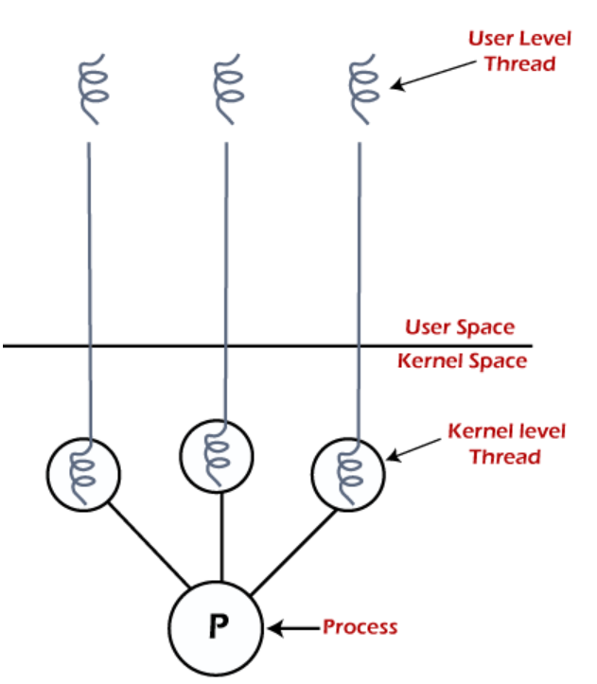
2. Kernel-level Thread
The kernel thread recognizes the operating system.
There is a thread control block and process control block in the system for each thread and process in the kernel-level thread.
The kernel-level thread is implemented by the operating system. The kernel knows about all the threads and manages them.
The kernel-level thread offers a system call to create and manage the threads from user-space. The implementation of kernel threads is more difficult than the user thread. Context switch time is longer in the kernel thread. Example: Window Solaris.

Slide 56
Benefits of Threads
Enhanced throughput of the system: When the process is split into many threads, and each thread is treated as a job, the number of jobs done in the unit time increases. That is why the throughput of the system also increases.
Effective Utilization of Multiprocessor system: When you have more than one thread in one process, you can schedule more than one thread in more than one processor.
Faster context switch: The context switching period between threads is less than the process context switching. The process context switch means more overhead for the CPU.
Responsiveness: When the process is split into several threads, and when a thread completes its execution, that process can be responded to as soon as possible.

Slide 57
Communication: Multiple-thread communication is simple because the threads share the same address space, while in process, we adopt just a few exclusive communication strategies for communication between two processes.
Resource sharing: Resources can be shared between all threads within a process, such as code, data, and files. Note: The stack and register cannot be shared between threads. There is a stack and register for each thread.

Slide 58
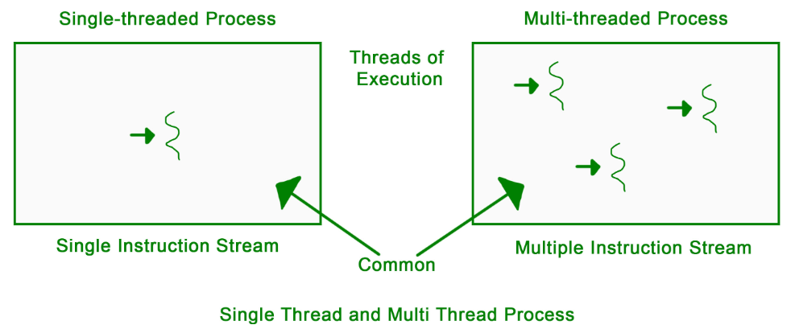
Multithreading
The concept of multi-threading needs proper understanding of these two terms – a process and a thread. A process is a program being executed.
A process can be further divided into independent units known as threads. A thread is like a small light-weight process within a process. Or we can say a collection of threads is what is known as a process.

Slide 59
Threading is a segment which divide the code into small parts that are of very light weight and has less burden on CPU memory. The concept of threading is designed due to the problem of fast and regular changes in technology and less the work in different areas due to less application.
Lifecycle of a thread
New: The lifecycle of a born thread (new thread) starts in this state. It remains in this state till a program starts.
Runnable: A thread becomes runnable after it starts. It is considered to be executing the task given to it.
Waiting: While waiting for another thread to perform a task, the currently running thread goes into the waiting state and then transitions back again after receiving a signal from the other thread.
Timed Waiting: A runnable thread enters into this state for a specific time interval and then transitions back when the time interval expires or the event the thread was waiting for occurs.
Terminated (Dead): A thread enters into this state after completing its task.

Slide 60
Benefits & Drawbacks
Benefits: -
Improves the performance and efficiency of a program
Enhance responsiveness in applications that involve user interaction.
Enables better resource utilization
Facilitate better code organization and modularity by dividing complex tasks into smaller, manageable units of execution
Drawbacks: -
If you don’t make use of the locking mechanisms properly, while investigating data access issues there is a chance of problems arising like data inconsistency and dead-lock.
If many threads try to access the same data, then there is a chance that the situation of thread starvation may arise. Resource contention issues are another problem that can trouble the user.
Display issues may occur if threads lack coordination when displaying data.

